Slide 1

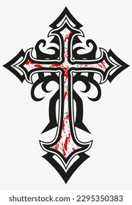
God, Man, and Superman:
Heroic Powers, Fragile Moments, and Religious Understanding
Dr. Gian S. Pagnucci
Chair of the Department of Language, Literature, & Writing
Indiana University of Pennsylvania
United States of America
15th International Conference
On Religion and Spirituality in Society
June 19, 2025
Università Sapienze di Roma
Italia

Slide 2
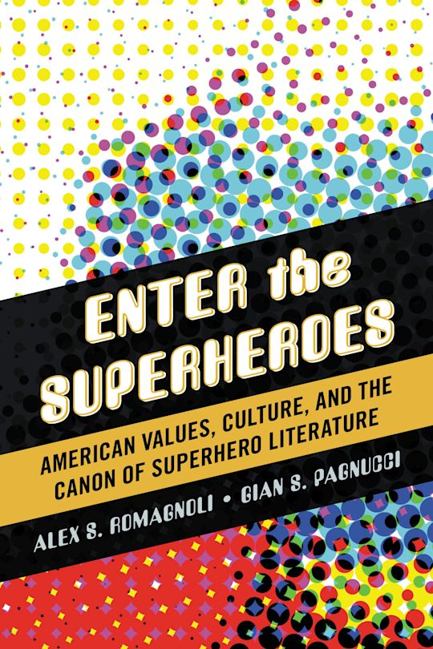
Superhero Stories & Spirituality
Presentation Goals:
To explore how superhero stories help audiences learn to cope with fragile moments in human life
How superhero stories link to empowering spiritual themes.
Presentation Sources:
Popular superhero texts (films and comics)
Passages from the New International Version (NIV) of the Bible
Comics Studies literature
Sources on “fragile moments”
Romagnoli & Pagnucci (Enter the Superheroes: American Values, Culture, and the Canon of Superhero Literature, 2013):
“Superhero stories have a seventy-year tradition. They represent an American mythology and significant cultural iconography ripe for exploration today. Within superhero stories can be found all our hopes, ideals, fears, dreams, and longings. It is time to give these stories their due. The time of the superhero has come.”

Slide 3
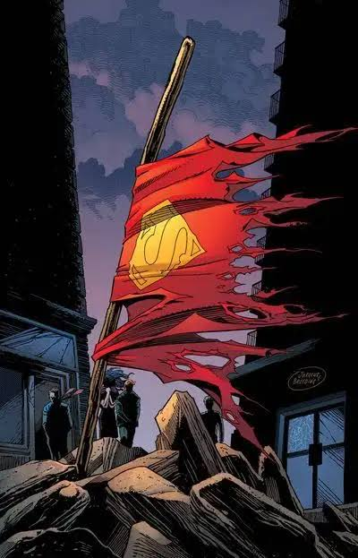
The Power of Fragile Moments
When we feel lost and need help
When we stumble and fail
When we think we can’t go on
When we are faced with a choice and know what we should do, but are afraid to do it
In superhero stories, power and fragilty intersect
As readers/viewers/believes, these stories help us understand how the divine and the human become one

Slide 4
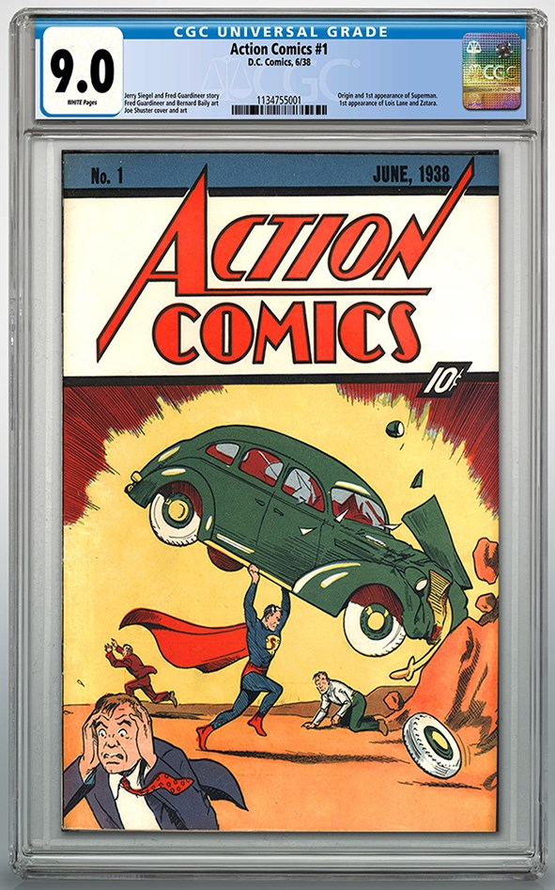
Superhero Stories Offer Hope in Us
Grant Morrison (Supergods, 2011):
“[W]e have a tendency to reenact the stories we tell ourselves. We learn as much (and sometimes more that’s useful) from our fictional role models as we do from the real people who share our lives. If we perpetually reinforce the notion that human beings are somehow unnatural aberrations in the ever-encroaching Void, that story will take root in impressionable minds and inform the art, politics, and general discourse of our culture in anti-life, anti-creative, and potentially catastrophic ways. If we spin a tale of guilt and failure with an unhappy ending, we will live that story to its conclusion, and some benighted final generation not far down the line will pay the price.
If, on the other hand, we emphasize our glory, intelligence, grace, generosity, discrimination, honesty, capacity for love, creativity, and native genius, those qualities will be made manifest in our behavior and in our works. It should give us hope that superhero stories are flourishing everywhere because they are a bright, flickering sign of our need to move on, to imagine the better, more just, and more proactive people we can be.”

Slide 5
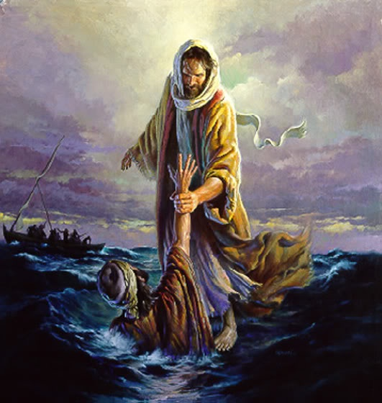
Peter Walks on Water
Matthew 14:22-33 (NIV):
²² Immediately Jesus made the disciples get into the boat and go on ahead of him to the other side, while he dismissed the crowd. ²³ After he had dismissed them, he went up on a mountainside by himself to pray. Later that night, he was there alone, ²⁴ and the boat was already a considerable distance from land, buffeted by the waves because the wind was against it.
²⁵ Shortly before dawn Jesus went out to them, walking on the lake. ²⁶ When the disciples saw him walking on the lake, they were terrified. “It’s a ghost,” they said, and cried out in fear.
²⁷ But Jesus immediately said to them: “Take courage! It is I. Don’t be afraid.”
²⁸ “Lord, if it’s you,” Peter replied, “tell me to come to you on the water.”
²⁹ “Come,” he said.
Then Peter got down out of the boat, walked on the water and came toward Jesus. ³⁰ But when he saw the wind, he was afraid and, beginning to sink, cried out, “Lord, save me!”
³¹ Immediately Jesus reached out his hand and caught him. “You of little faith,” he said, “why did you doubt?”
³² And when they climbed into the boat, the wind died down. ³³ Then those who were in the boat worshiped him, saying, “Truly you are the Son of God.”

Slide 6
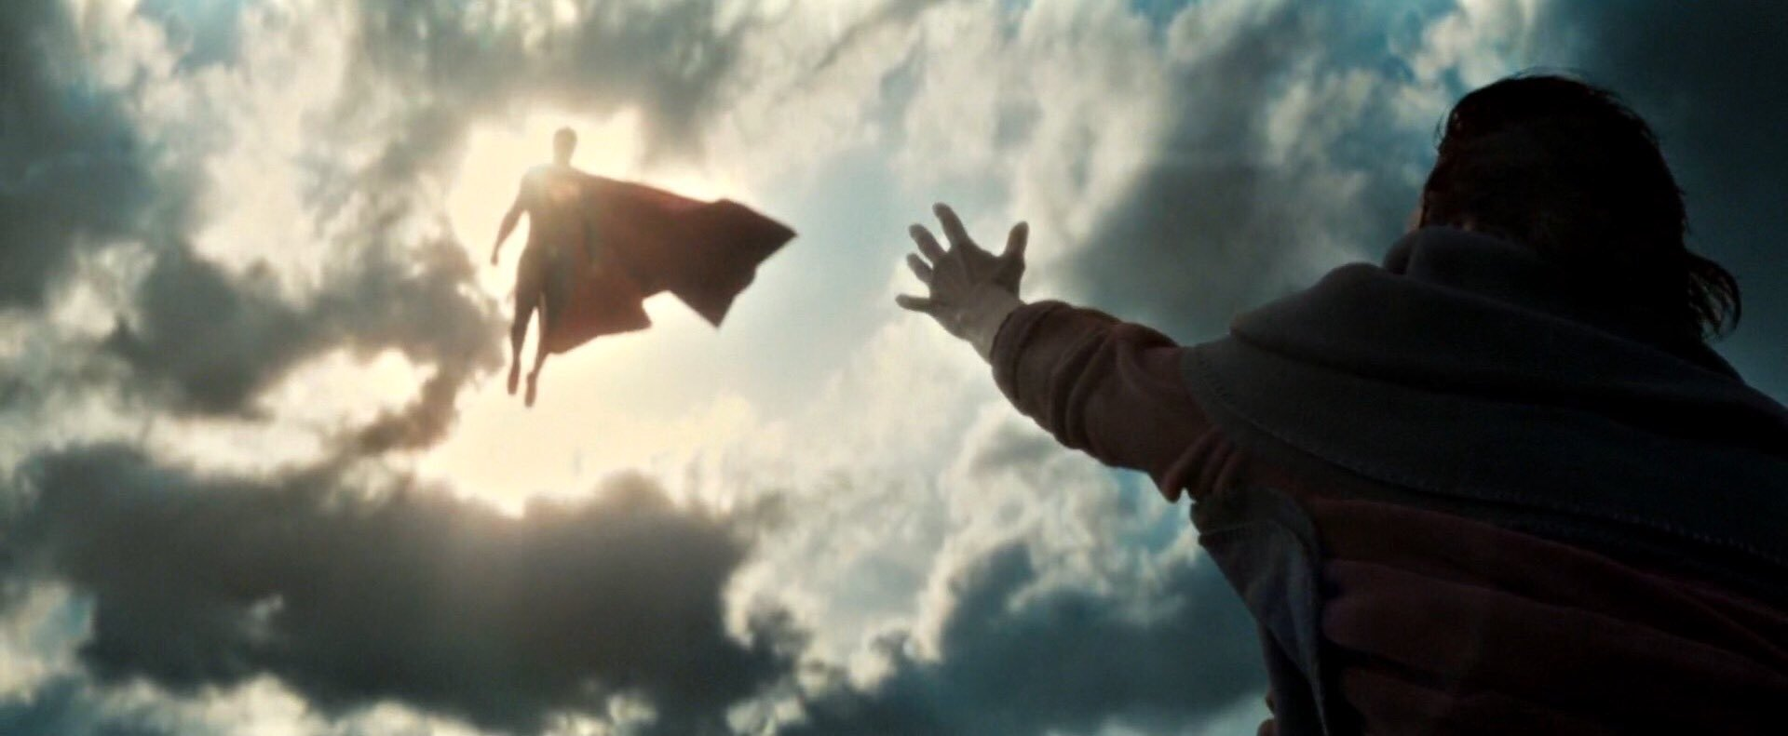
The Man of Steel
Superman is All Powerful.
An alien from the planet Krypton, the earth’s yellow sun gives him god-like powers:
Invulnerability
Super strength and speed
Flight
Heat and x-ray vision
Super hearing
He chooses to use those powers to help others.
Enduring Heroes:
Superman was Created in 1939 by Jerry Siegle and Joe Shuster.
90 years of Superman stories in all media forms.
Superman and other superheroes have persisted for decades and join the pantheon of other mythological heroes (Hercules, Gilgamesh, Beowulf, & King Arthur)

Slide 7
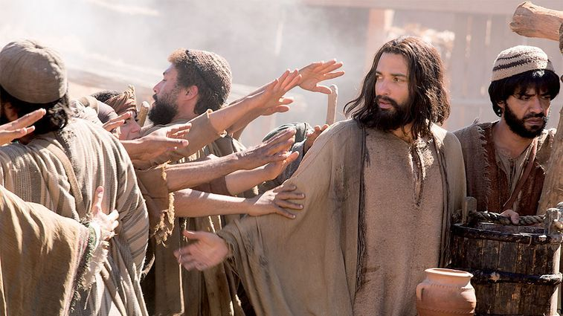
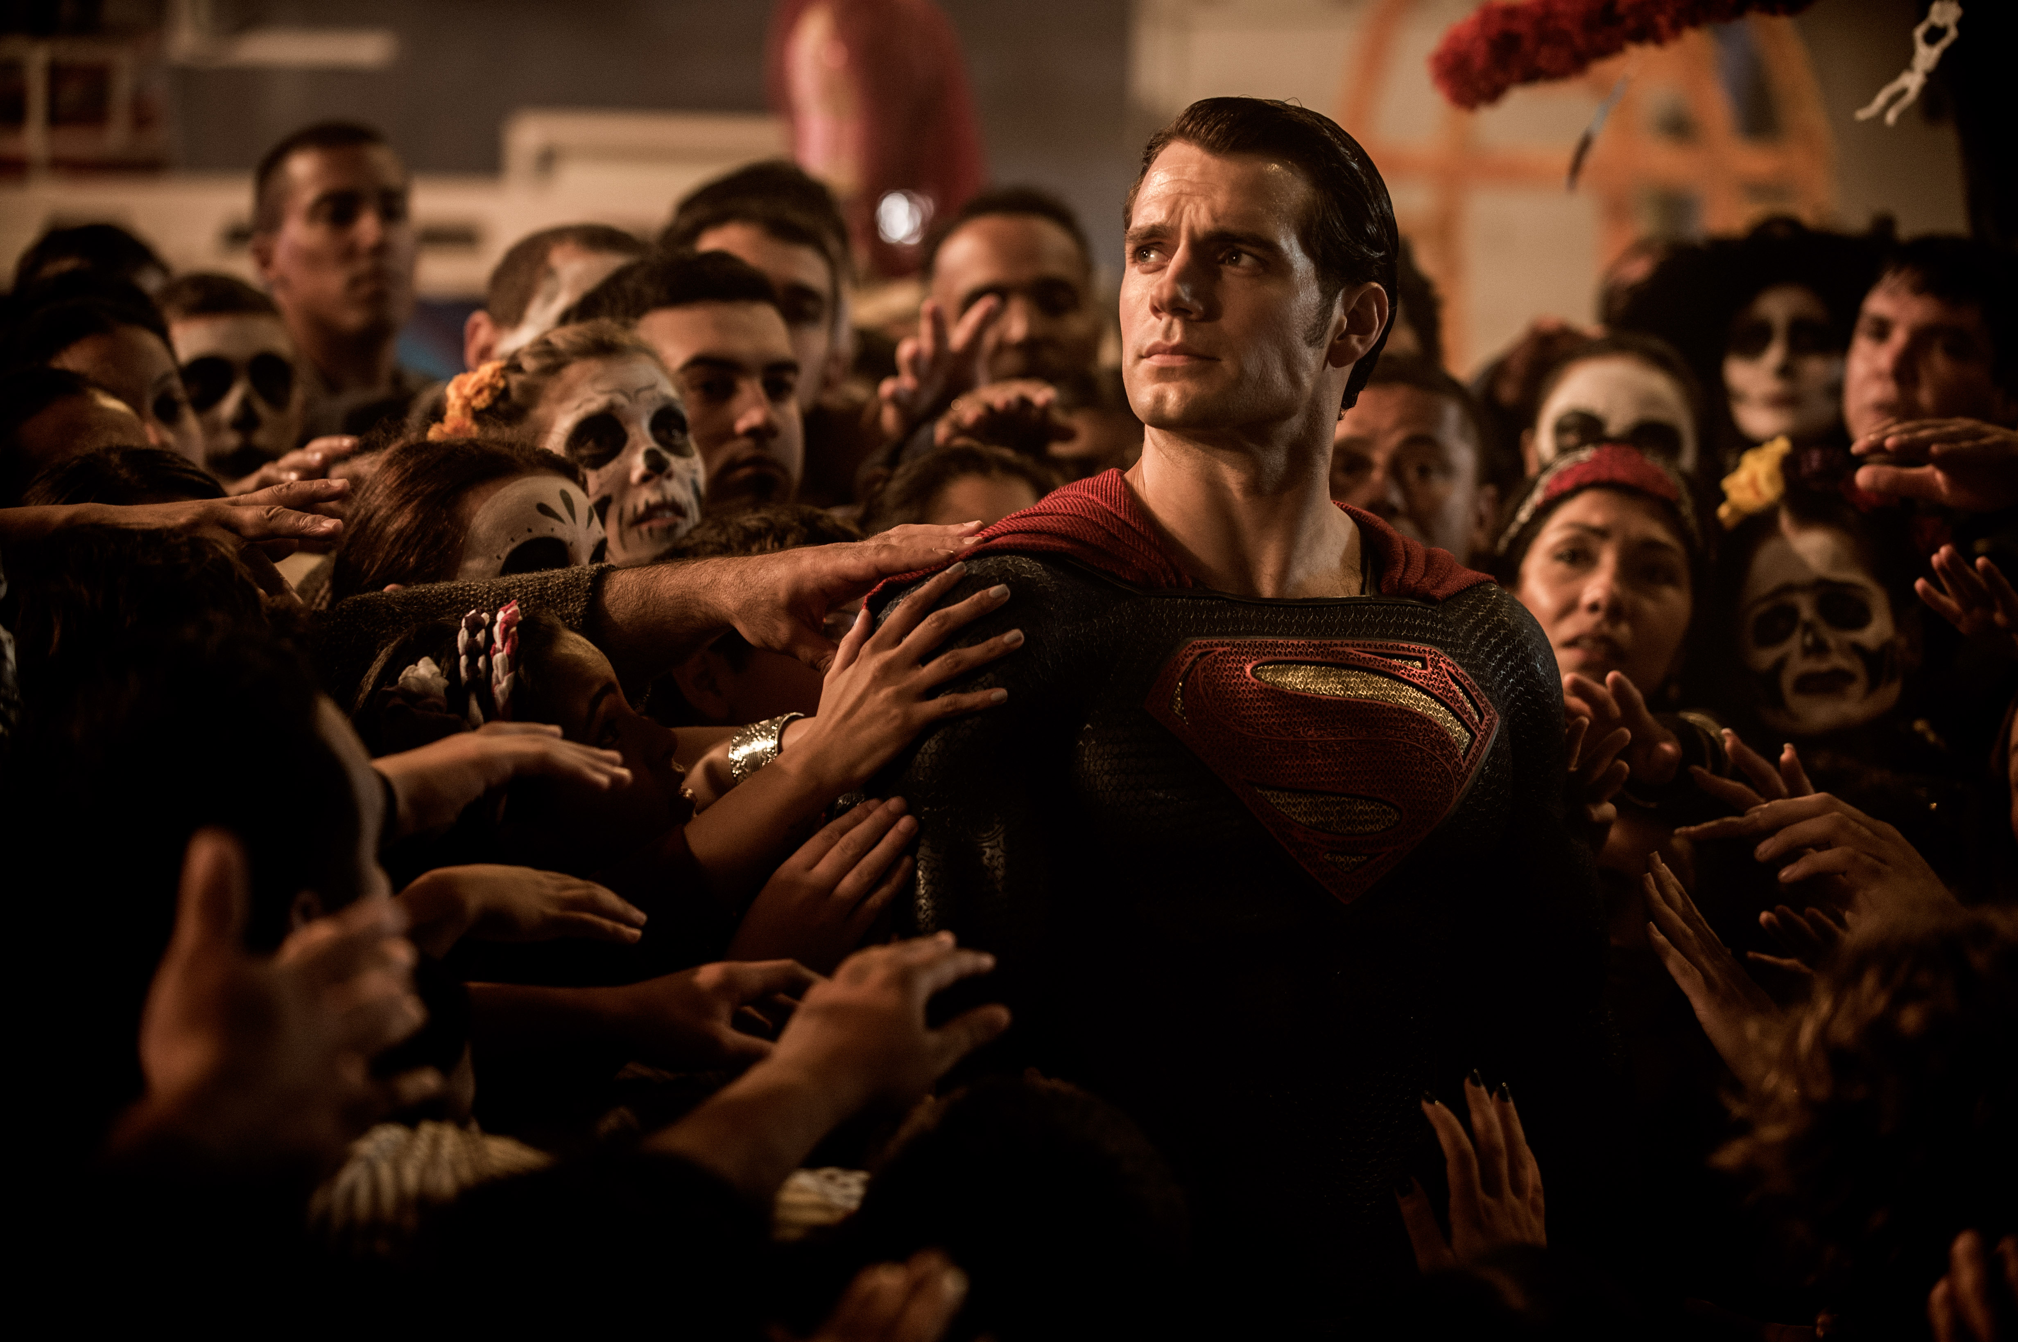
A God You Can Touch
Matthew 14:35-36 (NIV):
“And when the men of that place recognized Jesus, they sent word to all the surrounding country. People brought all their sick to him and begged him to let the sick just touch the edge of his cloak, and all who touched it were healed.”
In Superman vs. Batman: Dawn of Justice, as word of Superman’s feats spreads, people begin to worship him like a god.

Slide 8
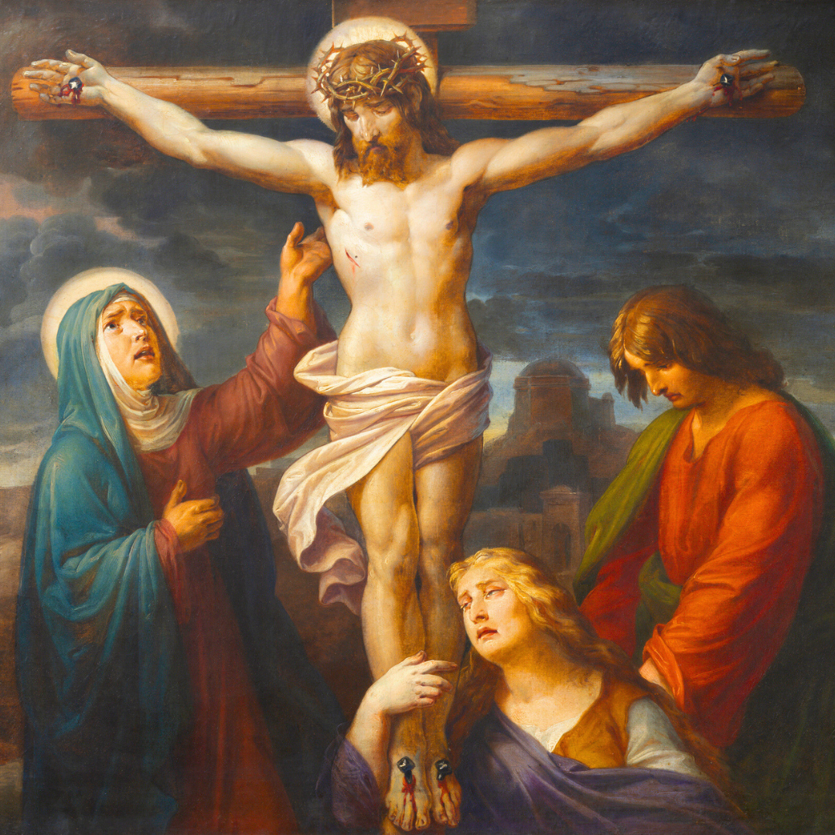
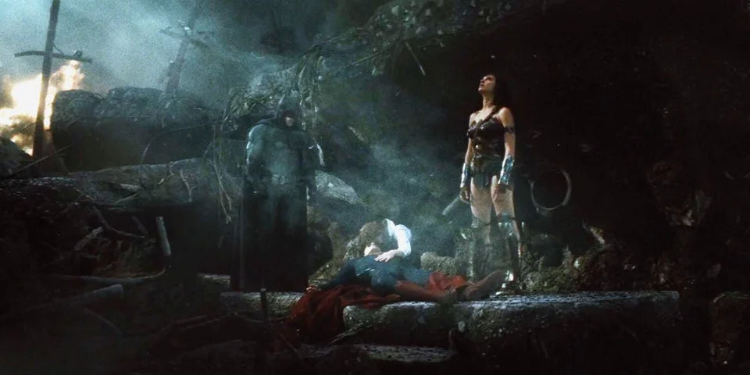
But Even Gods Can Die
Death and loss heighten our fragility
And we are faced with the question of how can endure

Slide 9
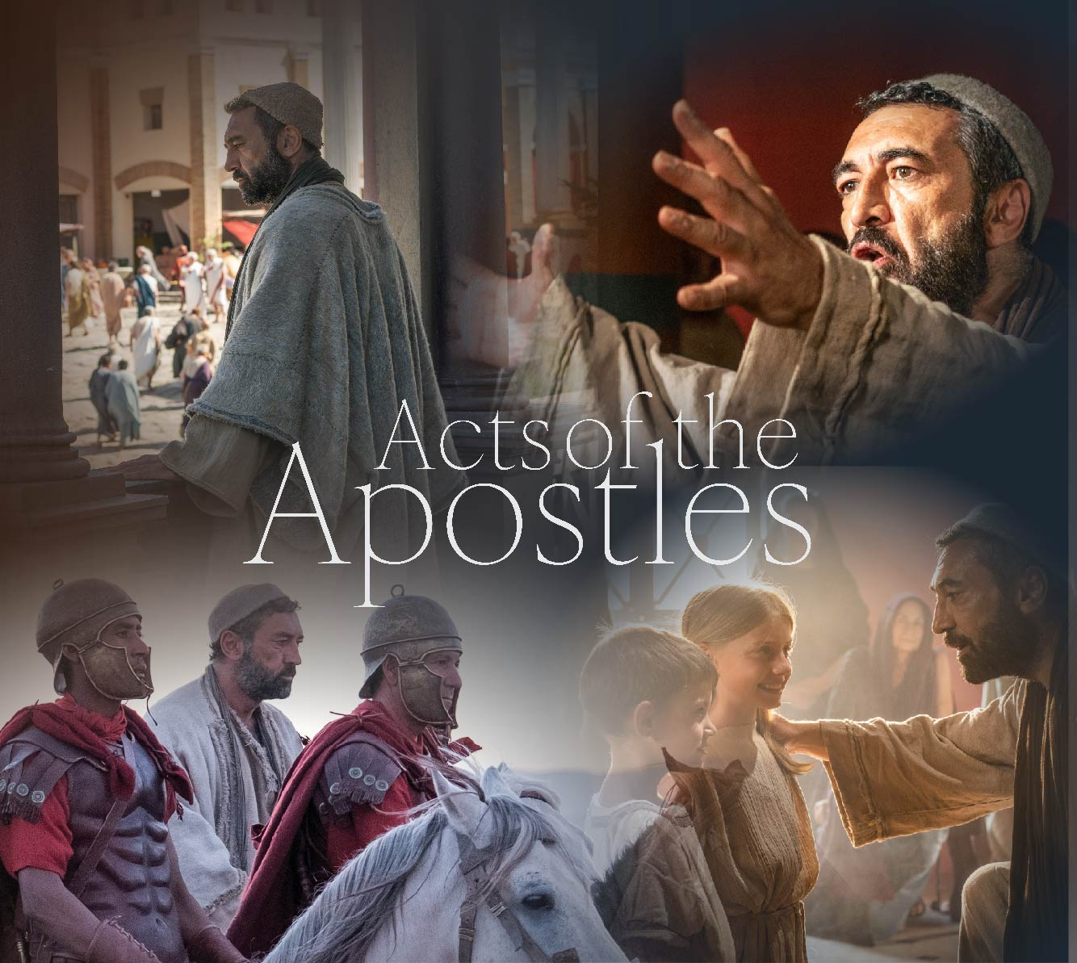
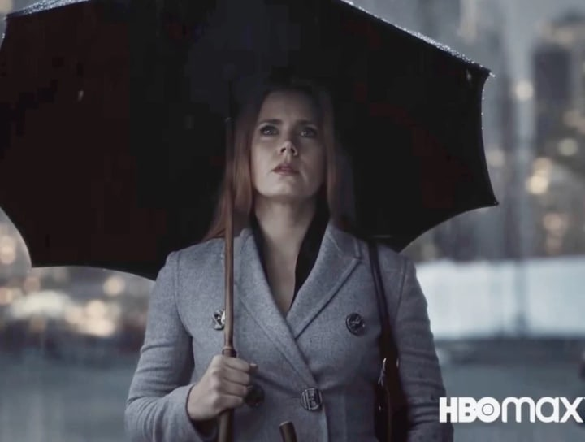
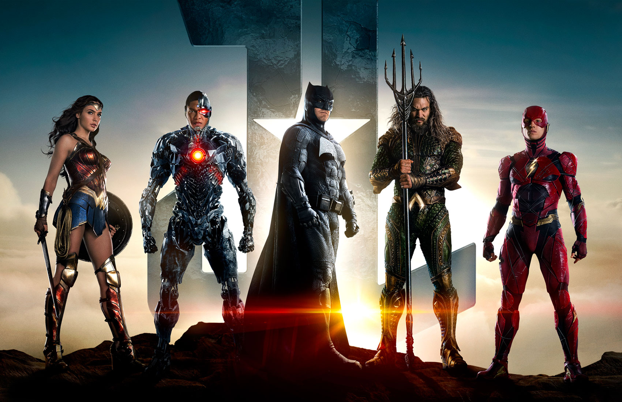
Superhero Stories Lesson One:
We Can Go On
Loss is part of life
Superhero stories show us how to keep going by finding purpose
Bruce Wayne (Justice League, 2017): “Superman was a beacon to the world. He didn't just save people; he made them see the best parts of themselves.”
John: Acts of the Apostles 20:21 (NIV):
“Again, Jesus said, “Peace be with you! As the Father has sent me, I am sending you.”

Slide 10

Julian Lennon: Life’s Fragile Moments
Photography collection
In an interview for TeNeues, Lennon said:
  “I’ve always been curious, whether that’s musically, or visually, or just about Life in general… I believe we all had a Camera in our hands as children, at some point, even the throw away ones! I guess it’s just the growth of those curiosities, as such… But behind it all, it’s about memory and emotions, about catching a moment in time, whether about your Life, or someone else’s or a situation, that you wish to cherish, or by which you wish to tell a story, or convey a message.”
Julian Lennon, (“Disconnected” Everything Changes, 2013):
  “Life deals you questions that you’ve answered with fault.
  But have you learned enough to balance the score?
  Life's fragile moments make us question our faith.
  Don't wait forever, you might be too late.”

Slide 11
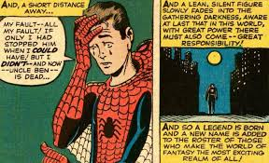
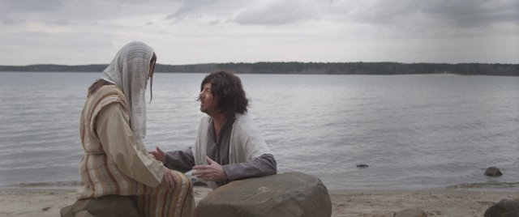
Superhero Stories Lesson One:
We All Fail, But That’s Ok
We make mistakes and bad choices
We can be selfish and hurt people
Superhero stories show us that heroes do this too, but we and the heroes can find our way again
Peter Parker (Amazing Fantasy #15, 1962):
“My fault—All my fault! If only I had stopped him when I could have! But I didn’t.”
John 21: 17 (NIV):
“The third time he said to him, ’Simon son of John, do you love me?”
Peter was hurt because Jesus asked him the third time, ’Do you love me?’ He said, ‘Lord, you know all things; you know that I love you.’
Jesus said, ’Feed my sheep.’”

Slide 12
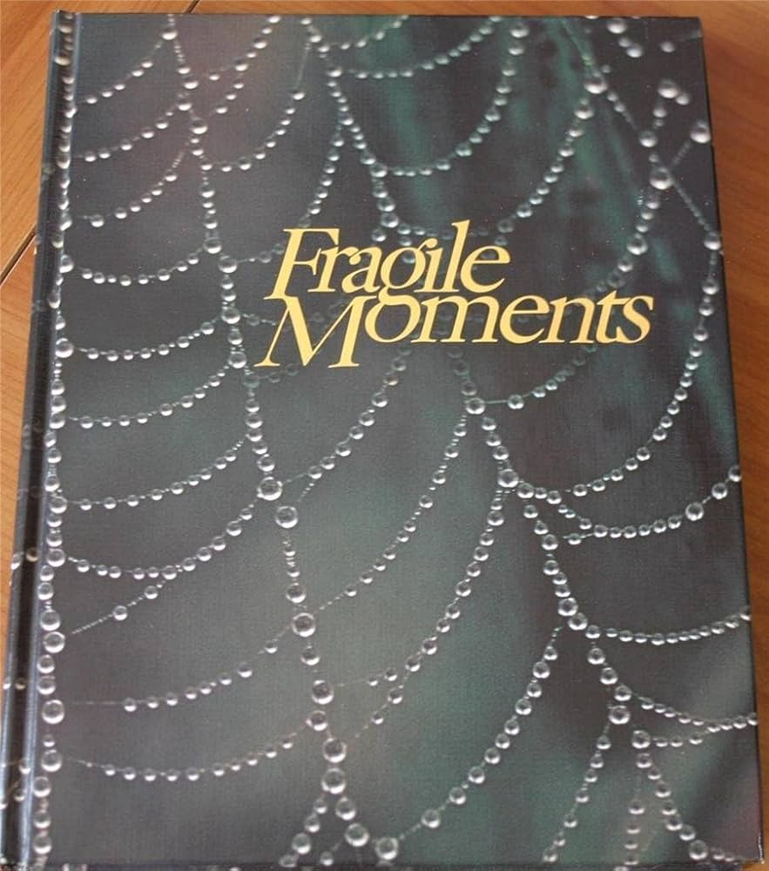
Phyllis Hobe’s
Fragile Moments: When God Speaks in Whispers
Arthur Gordon (Fragile Moments: When God Speaks in Whispers, Guideposts 1980):
“One of the best speeches I ever heard was made by a little man who came into our schoolroom one day and was invited to say a few words to us. I don’t remember who he was , and probably I am not quoting him verbatim, but what he said was close to this: Love life. Be grateful for it always. And show your gratitude by not shying away from its challenges. Try always to live a bit beyond your capacities. You’ll find that you never succeed.”
Book Review by Gail: “I have loved and cherished a copy of this book since it was purchased in 1980. Lovely and sweet pieces by sometimes forgotten authors, poems, Bible verses and other uplifting and though provoking writings that should be remembered.

Slide 13
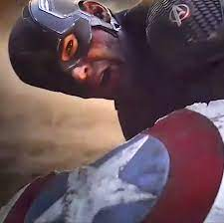
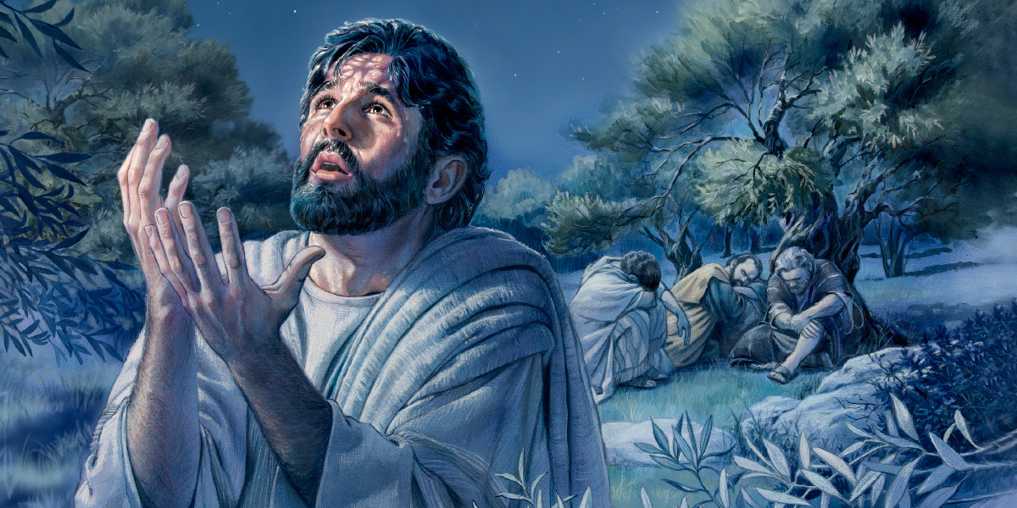
Superhero Stories Lesson Three:
We Are Stronger Than We Know
We are often challenged, and things can seem so overwhelming
Superhero stories teach us that being knocked does not matter: We have it in us to stand back up
Avengers: Endgame (2019):
Thanos to Captain America after breaking Cap’s shield: “Stay down.”
In answer, Cap climbs back to his feet, holding the broken shield.
Mathew 26: 39 (NIV):
“And going a little farther he fell on his face and prayed, saying, ’My Father, if it be possible, let this cup pass from me; nevertheless, not as I will, but as you will.’”

Slide 14
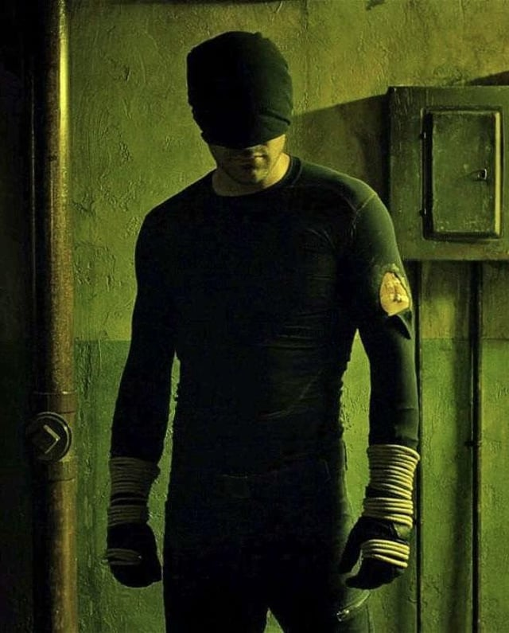
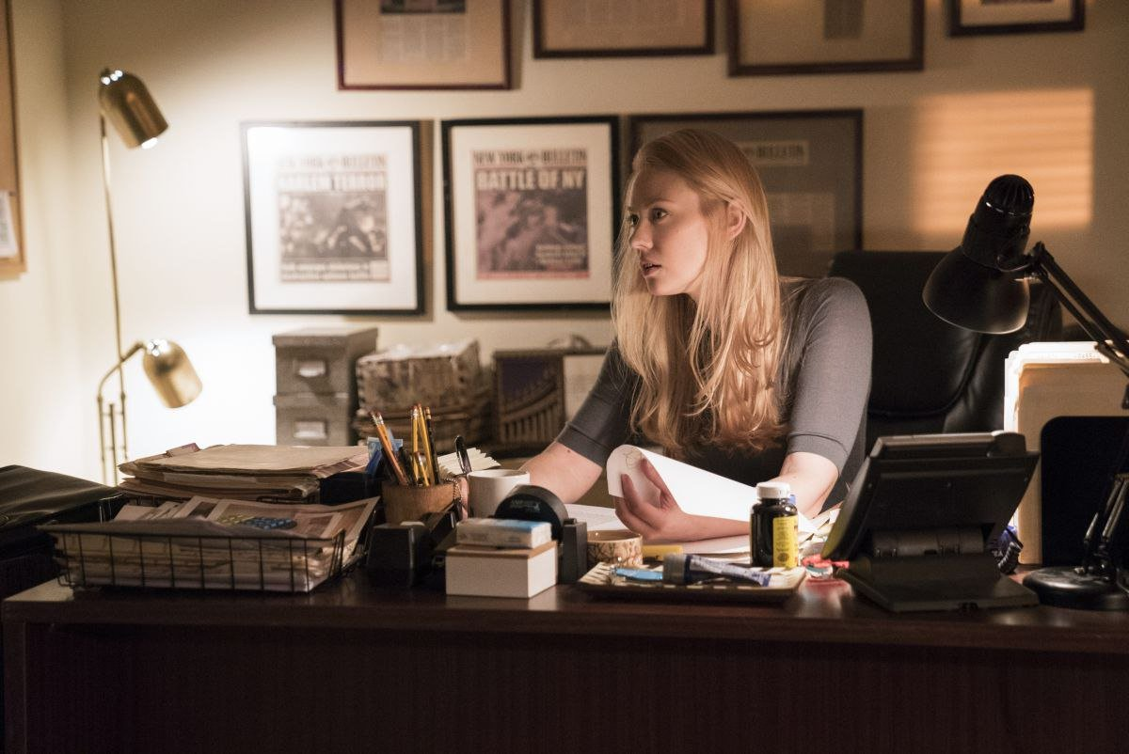
We Are All Heroes
Karen Page (Daredevil, “A Cold Day in Hell’s Kitchen,” 2016):
“What is it, to be a hero? Look in the mirror and you’ll know. Look into your own eyes and tell me that you are not heroic. That you have not endured or suffered or lost the things you care about most.
“And yet, here you are, a survivor of Hell’s Kitchen [or ROMA], the hottest place anyone’s ever known, a place where cowards don’t last long, so you must be a hero. We all are. Some more than others, but none of us alone…Because a hero isn't someone who lives above us, keeping us safe. A hero is not a god or an idea. A hero lives here...on the street, among us, with us. Always here but rarely recognized.
Look in the mirror and see yourself for what you truly are…You're a hero.”

Slide 15
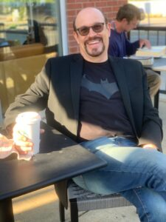
Superhero Smash:
Gian’s Livestream Radio Show
Website: http://pagnucci.org
  Then click the Big
  Superhero Smash Button
Airs live on WIUP FM 90.1
Thursday mornings
from 11 a.m.-Noon (Eastern USA)
All summer long
Livestream from anywhere
For the best in superhero music and comic book lore

Slide 16
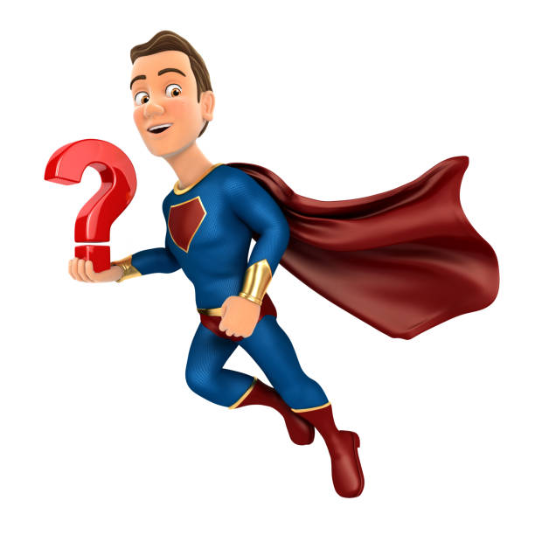
Questions and Comments
What do you think?
What do you want to ask about?
What would you like to discuss further?

Slide 17
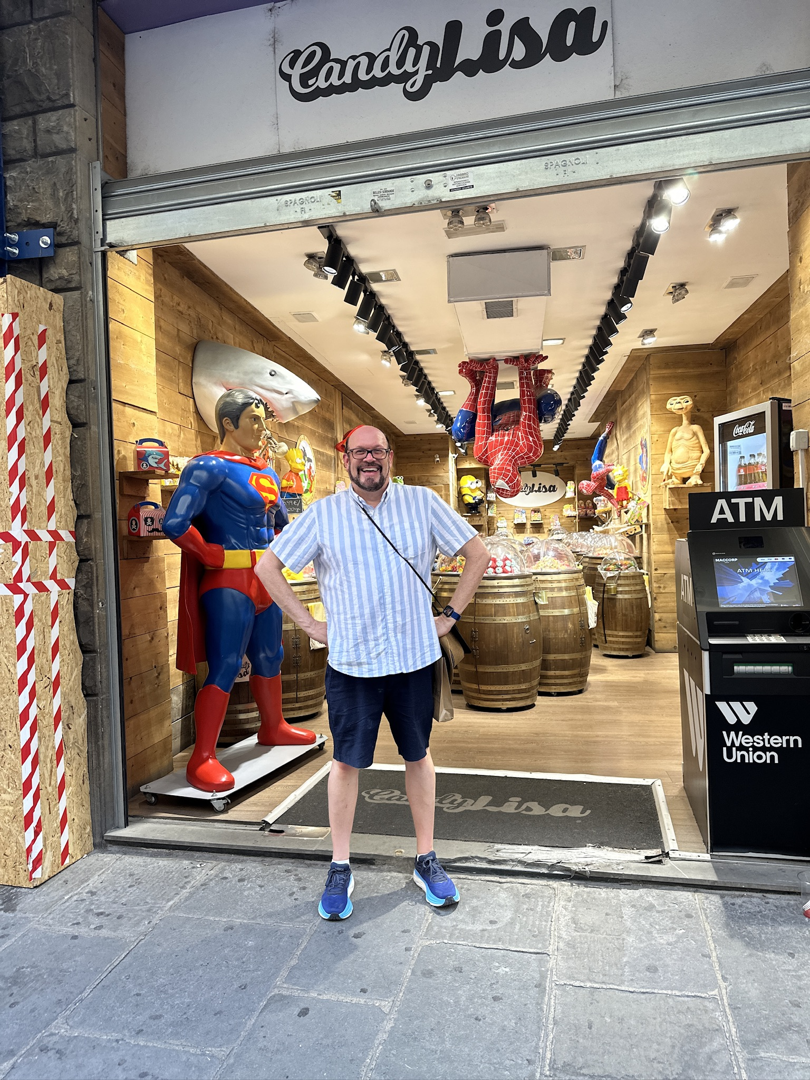
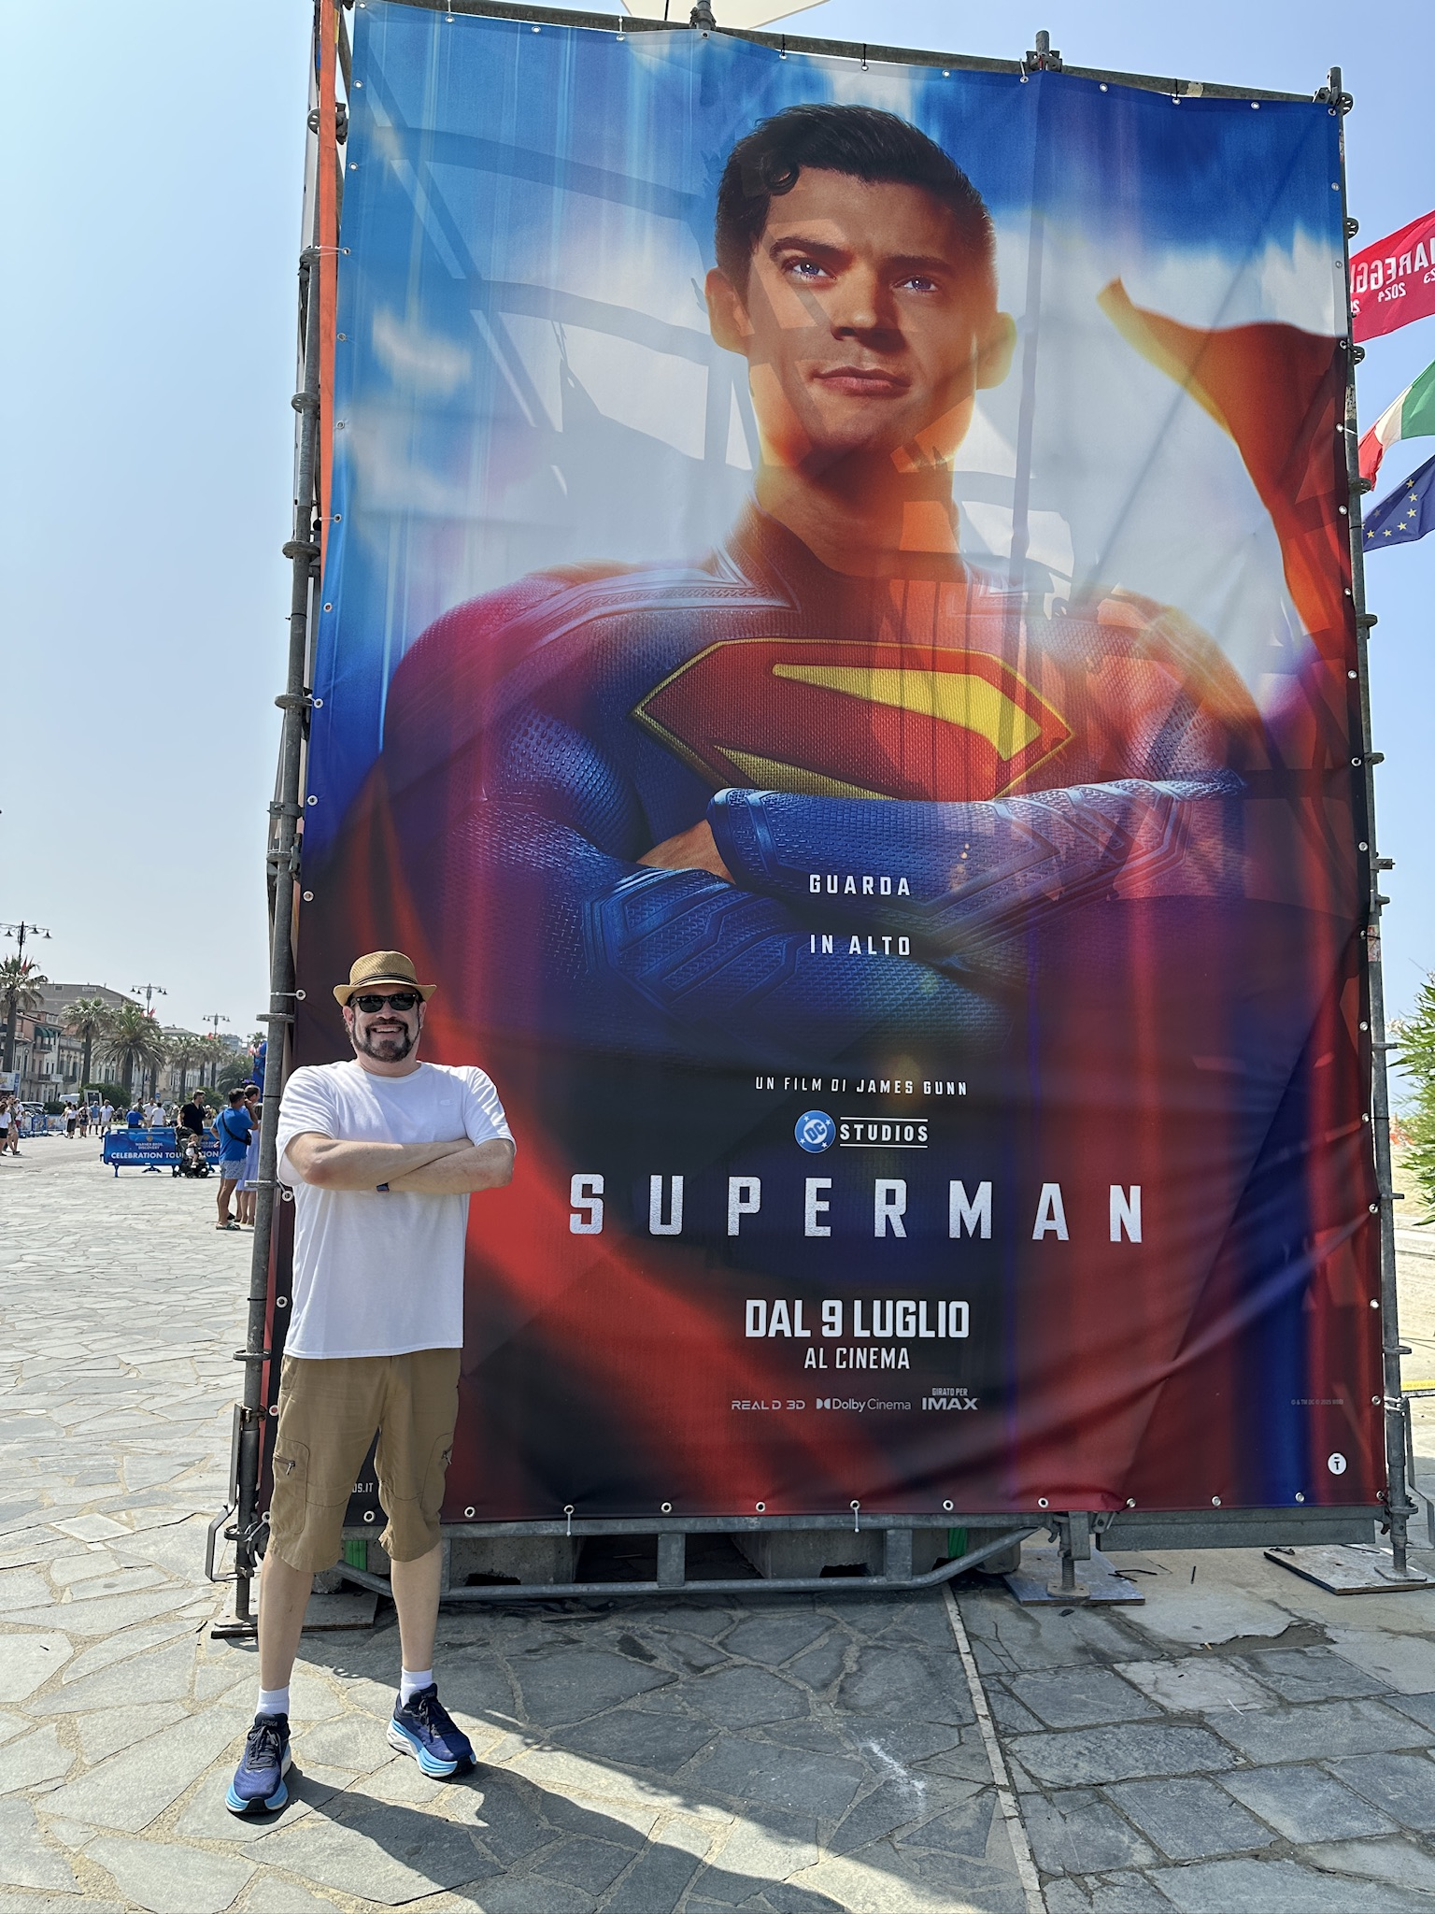
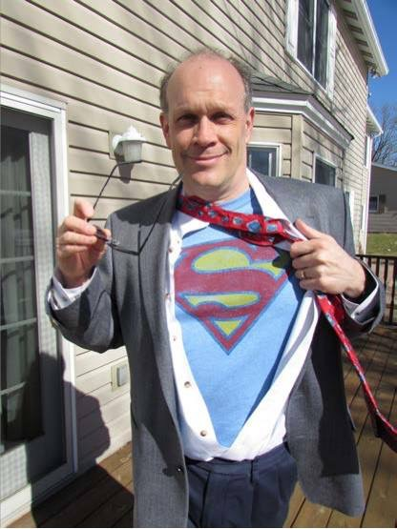
Gian’s Contact Information
The Super Take Away…
“You don’t need superpowers to be a hero.
The only thing it takes to be a hero
is the courage to do what’s right
when someone needs your help.”
Superman & Spiderman in Firenza
Website: http://pagnucci.org
Email: pagnucci@iup.edu
Superman in Viareggio
Clark Kent? in America

Slide 18
Power and Fragility
Peter responds to Jesus with passion and boldness
Seeing Jesus miraculously walking on the water, Peter asks to perform the same feat
And Jesus grants his request
But then he doubts
This is a fragile moment

